Slide 1
Computer vision based fall detection by a convolutional neural network
- Miao Yu, Liyun Gong, Stefanos Kollias
- ACM 2017 11

Slide 2
ABSTRACT
computer vision based fall detection system
Recoded video -> background subtraction -> body silhouette
for elderly people
Notes:
녹화된 비디오 > 배경제거 > 실루엣 추출
노인들

Slide 3
applied for classification of different classes of human postures
e.g., bend, stand, lie and sit - normal
i.e., lying posture is detected in the floor region - fall
this work is the first attempt using cnn
Notes:
움직임을 분류함
노말상태와 넘어진상태
Cnn에 처음 적용했음.

Slide 4
INTRODUCTION
One important issue for the home care
-> to detect whether an elderly person has fallen or not.
87% of all fractures are caused by falls
Notes:
홈 헬스케어중에 가장 중요함.
노인이 언제 넘어졌는지 아닌지 여부
87퍼센트의 골절은 넘어짐사고임.

Slide 5
Different methods
Accelatoration sensors
- they are either inconvenient (have to wear)
both floor vibration and sound sensing
- easily affected by noises
using computer vision
Notes:
두가지 방법이 있었는데
가속도 센서(가지고다니기 불편함)
바닥 진동과 소리센서(소음이 쉽게 검출됨).
그래서 컴퓨터비전씀

Slide 6
head’s velocity information
shape change information
-> two methods produce high false detecting
multiple calibrated cameras
- to reconstruct the 3D shape of people.
Notes:
기존의 머리추출하고 형태를 하는 방법이 있었지만 오류가 많았음
그래서 여러대의 멀티카메라를 사용함

Slide 7
near the floor over a predefined period of time
-> alarm
. Neural network and support vector machine
consecutive silhouettes as features (Motion)
-> hidden Markov model (HMM) for classifying fall and non-fall activities.
Notes:
일정 바닥에 있으면 알람을 울림.
그리고 신경망과 벡터머신을 이용해서 연속적인 실루엣들을
분류하기위한 Hmm을 학습

Slide 8
the CNN much higher accuracy than
the traditional machine learning method
human silhouette is extracted from the raw video stream.
- different classes of postures(stand, sit, bend and lie)
- posture is detected in the floor region.
Notes:
원본비디오에서 실루엣을 추출함.
바닥 영역에서 누워있는 것을 감지

Slide 9
2 BACKGROUND SUBTRACTION
In visual surveillance, a common approach
the codebook background subtraction method is applied.
- better than mixture of Gaussians (MoG)
- pixel-based

Slide 10
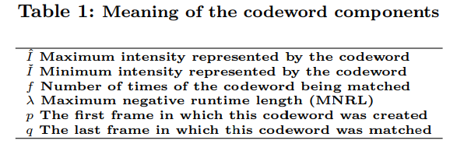
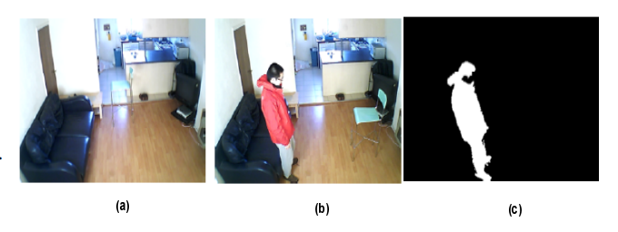


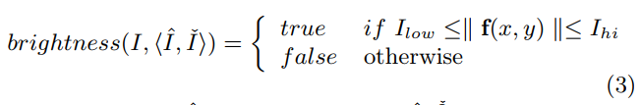
Notes:
두가지 조건이 만족되면 실루엣을 추출함.
배경과 전경의 픽셀 위치의 색을 비교해서 다를 경우에 해당하는 실루엣을 추출.

Slide 11
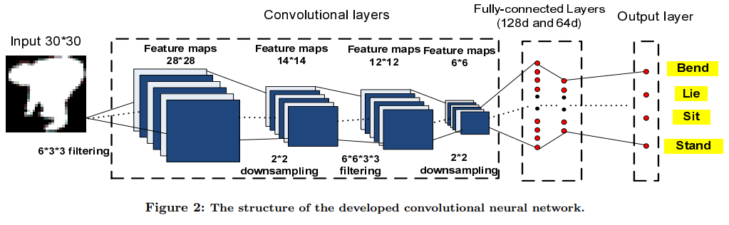
3 CNN FOR POSTURES RECOGNITION AND FALL DETECTION
The trained CNN can then be applied for classifying different types of postures.
Notes:
동작을 cnn으로 학습시킴

Slide 12
When a lying posture is detected within the floor region, a fall is reported.
For the floor region
-> marked manually
-> detected by an unsupervised method based on the foot positions
Notes:
바닥 영역을 표시해야하는데
미리 영역을 수동으로 지정하거나
발의 위치가 표시안된 곳을 정함

Slide 13
4 EXPERIMENTAL RESULTS
10 people
A USB camera(320X240), VC++ 6.0 (with OpenCv library 1.0)
Keras for the CNN training
A posture dataset containing 3216 postures
(including 804 stands, 769 sits, 810 lies and 833 bends)

Slide 14
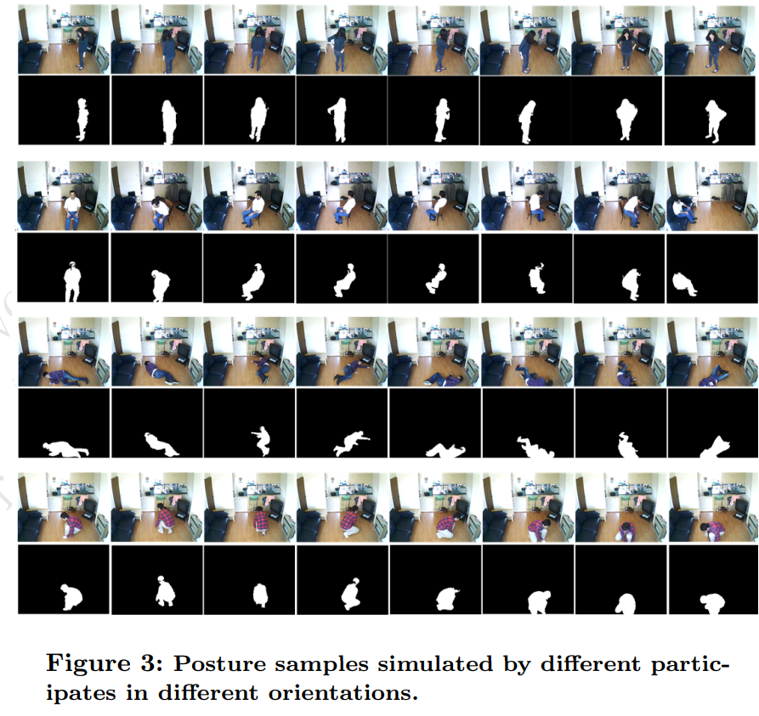
4.1 Posture classification results comparison
each person was asked to simulate postures in different directions
robust to view angles
Notes:
사람들에게 다양한 각도에서 자세를 취해달라고 해서 각도에 강하다.

Slide 15
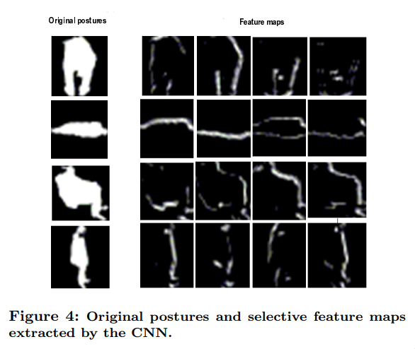
coincides with our intuition
- a binary human silhouette image
- be well represented by its edge.
Notes:
직관과 일치했다.
실루엣의 엣지를 땄더니 대표적인 엣지와 같았음.

Slide 16
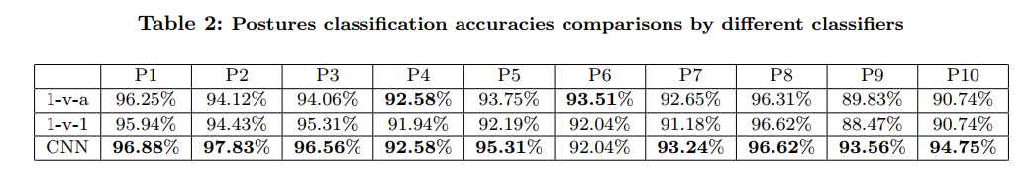
Notes:
CNN이좋다.

Slide 17
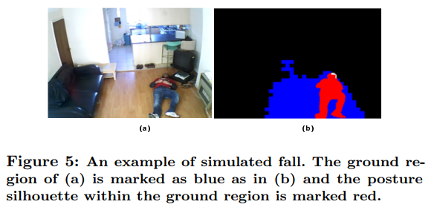
4.2 Fall detection comparison

Slide 18
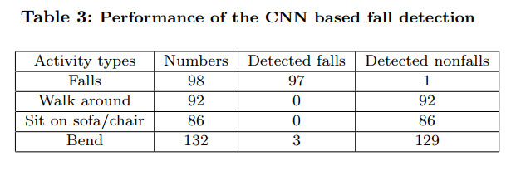

Slide 19
5 CONCLUSIONS
we will exploit information
multi-modality sensors (such as audio and video sensors)
deep learning techniques for developing a more robust fall detection system.

